Slide 1
ASP.NET MVC Introduction
By: Thomas Noelcke

Slide 2
MVC Architecture
View
URL Requests
Displays
Renders
Model
Controller
Manipulates

Slide 3
MVC Architecture
View
URL Requests
Displays
Renders
A Whole New World. (When it comes to DBS)
Model
Controller
Manipulates

Slide 4
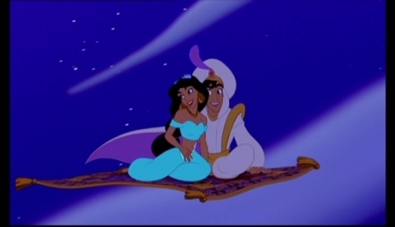
Database/Storing data A whole new world.

